Slide 1

Project #3
Stock Signals Trading Analysis
Brandon Allen
Mete Ozkazanc
Ryan Goda
Notes:
Ryan

Slide 2


Introduction
In this project, we are utilizing LSTM to predict and analyze signals relating to stock prices.
We will be training our model to predict stock buy & sell signals using any ticker of choice.
Notes:
Mete

Slide 3
Our Data and Objectives
Our main objectives for this project includes predicting the stock prices through LSTM Neural Network Nodes.
In performing our test and analysis, we will be utilizing these nodes and their storage capabilities to accurately predict our stock prices.
Ease of Use - Our goal is to allow the user to act on buy / sell signals.
We utilized a Yahoo Finance Library to pull stock price information pertaining to that specific select stock.
Notes:
Ryan

Slide 4

Our Code
Notes:
Brandon

Slide 5
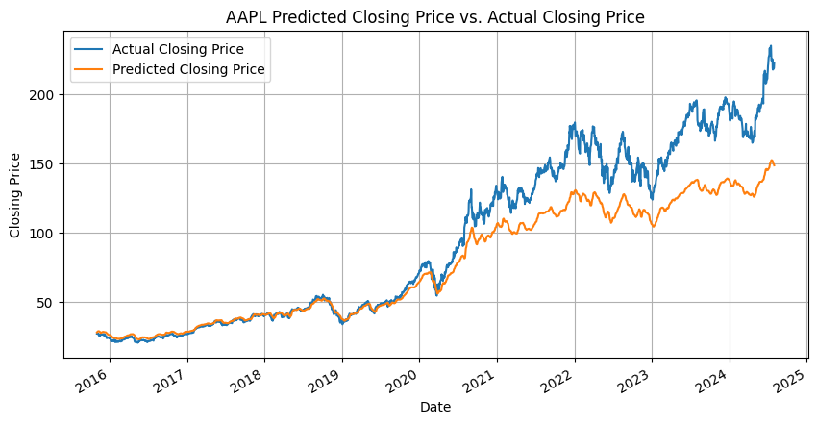
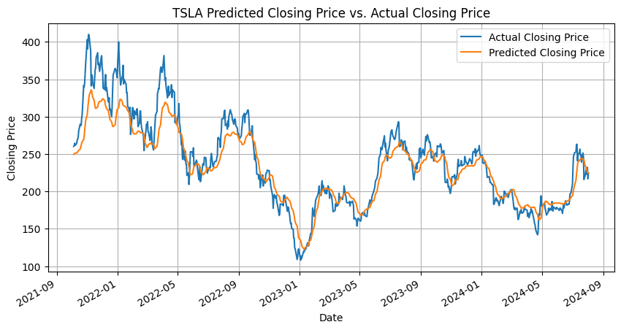

Results / Findings
Comparison Graphic
For lengthy datasets, as our X-Axis (Time & Date) increases, the predictions of our plot begin to deviate. This is expected.
In opposition, if our dataset isn’t as lengthy, the margin of error is decreased in our prediction.
Cumulative Return Graphic:
Notes:
Ryan

Slide 6


Conclusion
In creating our code, we enabled a “ticker-choice” allowing the user to select any stock of choice to analyze. It is intended to be easy to use without you having to be an expert in stock trading.
If given the opportunity to continue working on this project, we would further backtest historical results based on the signals and find ways to implement better thresholds for the buy/sell signals to increase returns.
Notes:
Mete

